Slide 1
Presentation on
INNOVATIVE MONITORING SYSTEM FOR TELEICU PATIENTS USING VIDEO
PROCESSING AND DEEP LEARNING
Chamarti Hareesh Kumar URK21CS7001
Rathipinni Yogiswar URK21CS1122
Nagothu Sravani Vimala Rani URK21CS2033
Karunya institutes of Technology and Sciences
B.Tech : Computer Science and Engineering
D A T E : 1 S T J U L Y 2 0 2 4

Slide 2


ACKNOWLEDGEMENT
I would like to express my heartfelt gratitude to everyone who supported and guided me throughout this project. Special thanks go to my Intel mentors for addressing my doubts in our regular meetings and providing invaluable insights. I also appreciate my peers for their encouragement and feedback. This project would not have been possible without the resources and inspiration from the AI and healthcare communities. I am thankful to my family for their unwavering support and understanding during the long hours devoted to this endeavor.

Slide 3

A B S T R A C T
This project introduces an innovative ICU Monitoring System utilizing YOLO v8, an advanced object detection model, to enhance patient care and monitoring in Intensive Care Units (ICUs). The system comprises two main components: a people detection model to identify healthcare professionals and visitors, and a movement detection model to monitor patient activity. This dual functionality aims to aid healthcare providers in maintaining vigilant patient oversight, thereby improving safety and response times. The integration of these technologies is designed to reduce the workload on ICU staff while ensuring patients receive timely and efficient care..

Slide 4
P R E S E N T A T I O N O V E R V I E W
01
02
03
04
05
06
07
08
09
10
Problem Statement
Technologies Used
Unique Idea Brief (Solution)
Team Member and Contribution
Features Offered
Conclusion
Process Flow
Future Work
Architecture Diagram
Contact and Reference

Slide 5

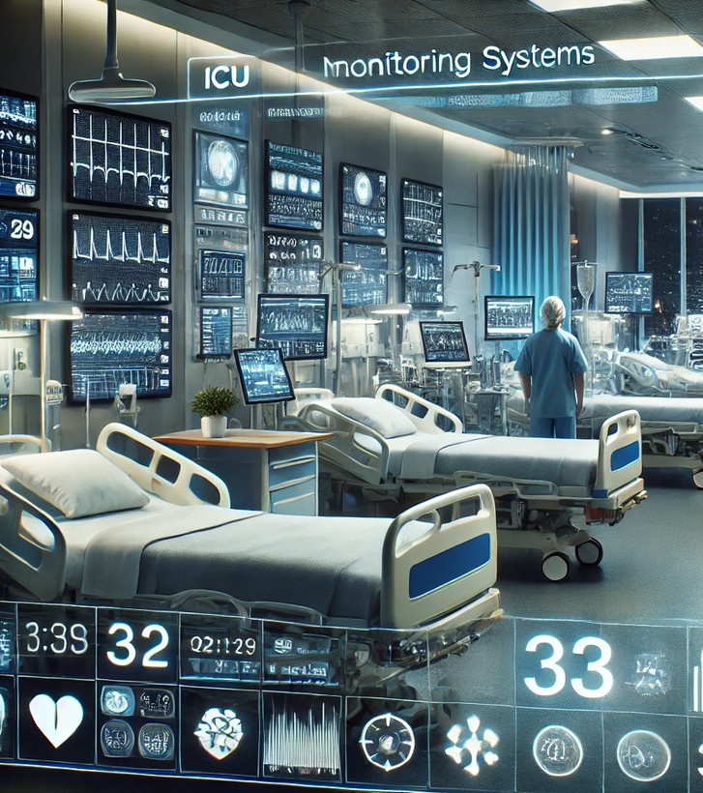
0 1 : P R O B L E M S T A T E M E N T
Intensive Care Units (ICUs) necessitate ongoing patient monitoring to ensure prompt intervention and optimal care. However, resource limitations often prevent healthcare professionals from being present at all times. Hence, there is a demand for an automated system capable of monitoring ICU settings, identifying medical staff and visitors, and notifying staff of patient movements. Such a system would support healthcare providers in delivering exceptional care levels. It should operate in real-time and seamlessly integrate with current hospital infrastructure.

Slide 6
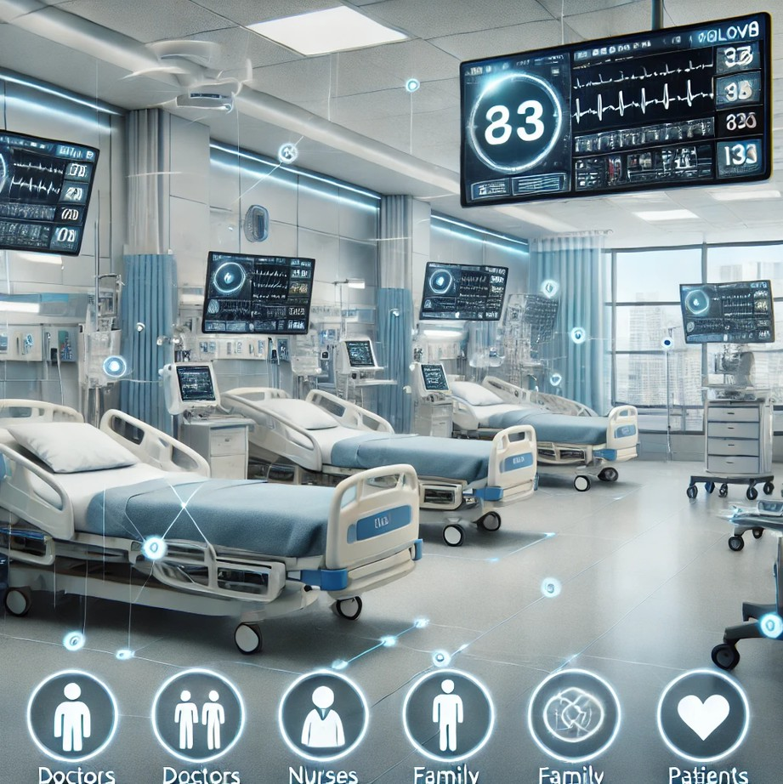
0 2 : U N I Q U E I D E A B R I E F ( S O L U T I O N )
Our ICU Monitoring System harnesses YOLOv8's capabilities to identify and categorize individuals within the ICU, distinguishing between doctors, nurses, family members, and patients. Furthermore, it continuously monitors patient movements and alerts staff to significant activity. This solution is designed to bolster patient safety, optimize resource utilization, and offer real-time support to healthcare providers.
By automating monitoring duties, our system enables medical personnel to concentrate on crucial responsibilities, thereby enhancing operational efficiency and patient outcomes.

Slide 7

0 3 : F E A T U R E S O F F E R E D
Monitors patient activity, detecting significant movements to promptly alert healthcare providers. This ensures swift responses to potential emergencies, like patients attempting to leave their beds.
People Detection: Identifies and classifies ICU occupants into categories such as doctors, nurses, family members, and patients. This helps in maintaining a record of who is present in the ICU at any given time.
Movement Detection: Monitors patient activity and detects significant movements to alert healthcare providers. This feature is crucial for immediate response to potential emergencies, such as a patient attempting to leave the bed.
Real-Time Monitoring: Analyzes live video feeds in real-time, offering immediate alerts and updates to healthcare teams.
User-Friendly Interface: Utilizes a Streamlit-based web application for effortless video upload and analysis. The interface is intuitive, allowing users to gain insights quickly without requiring extensive technical expertise.
Scalability: Integrates seamlessly with existing ICU monitoring systems, enhancing overall functionality. Its modular design facilitates easy expansion and customization to meet the unique requirements of different healthcare facilities.

Slide 8
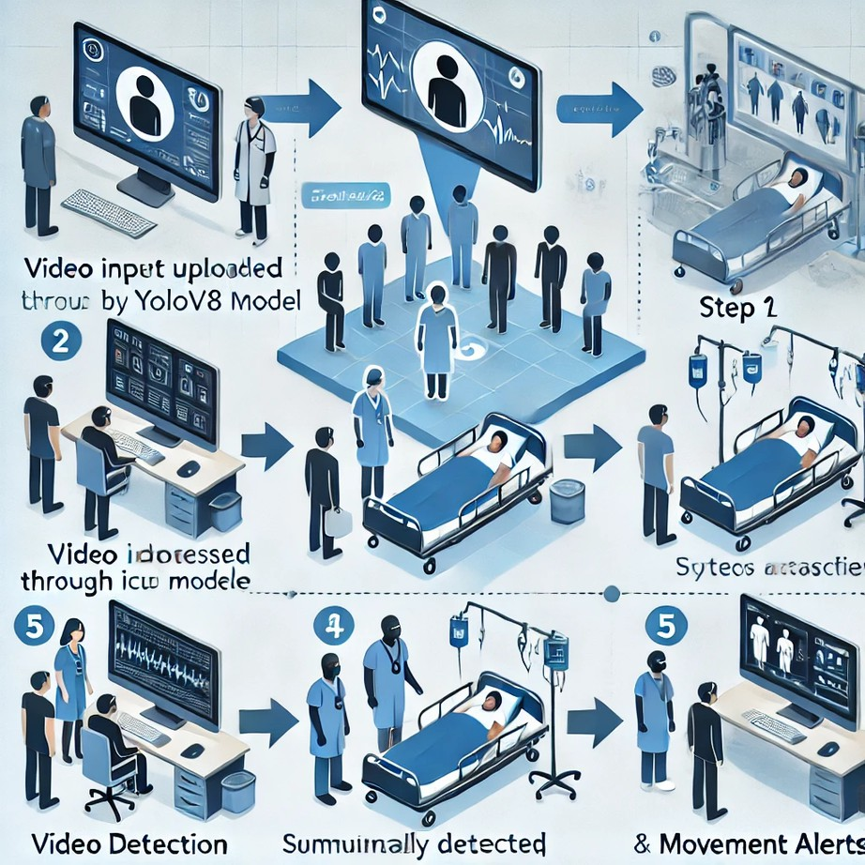
0 4 : P R O C E S S F L O W
Step 1: Video input is uploaded through the web interface.
Step 2: The video is processed by the YOLOv8 model for people detection.
Step 3: The system identifies and classifies individuals in the ICU.
Step 4: Simultaneously, the video is analyzed for patient movement.
Step 5: The results are displayed, showing detected people and movement alerts.

Slide 9
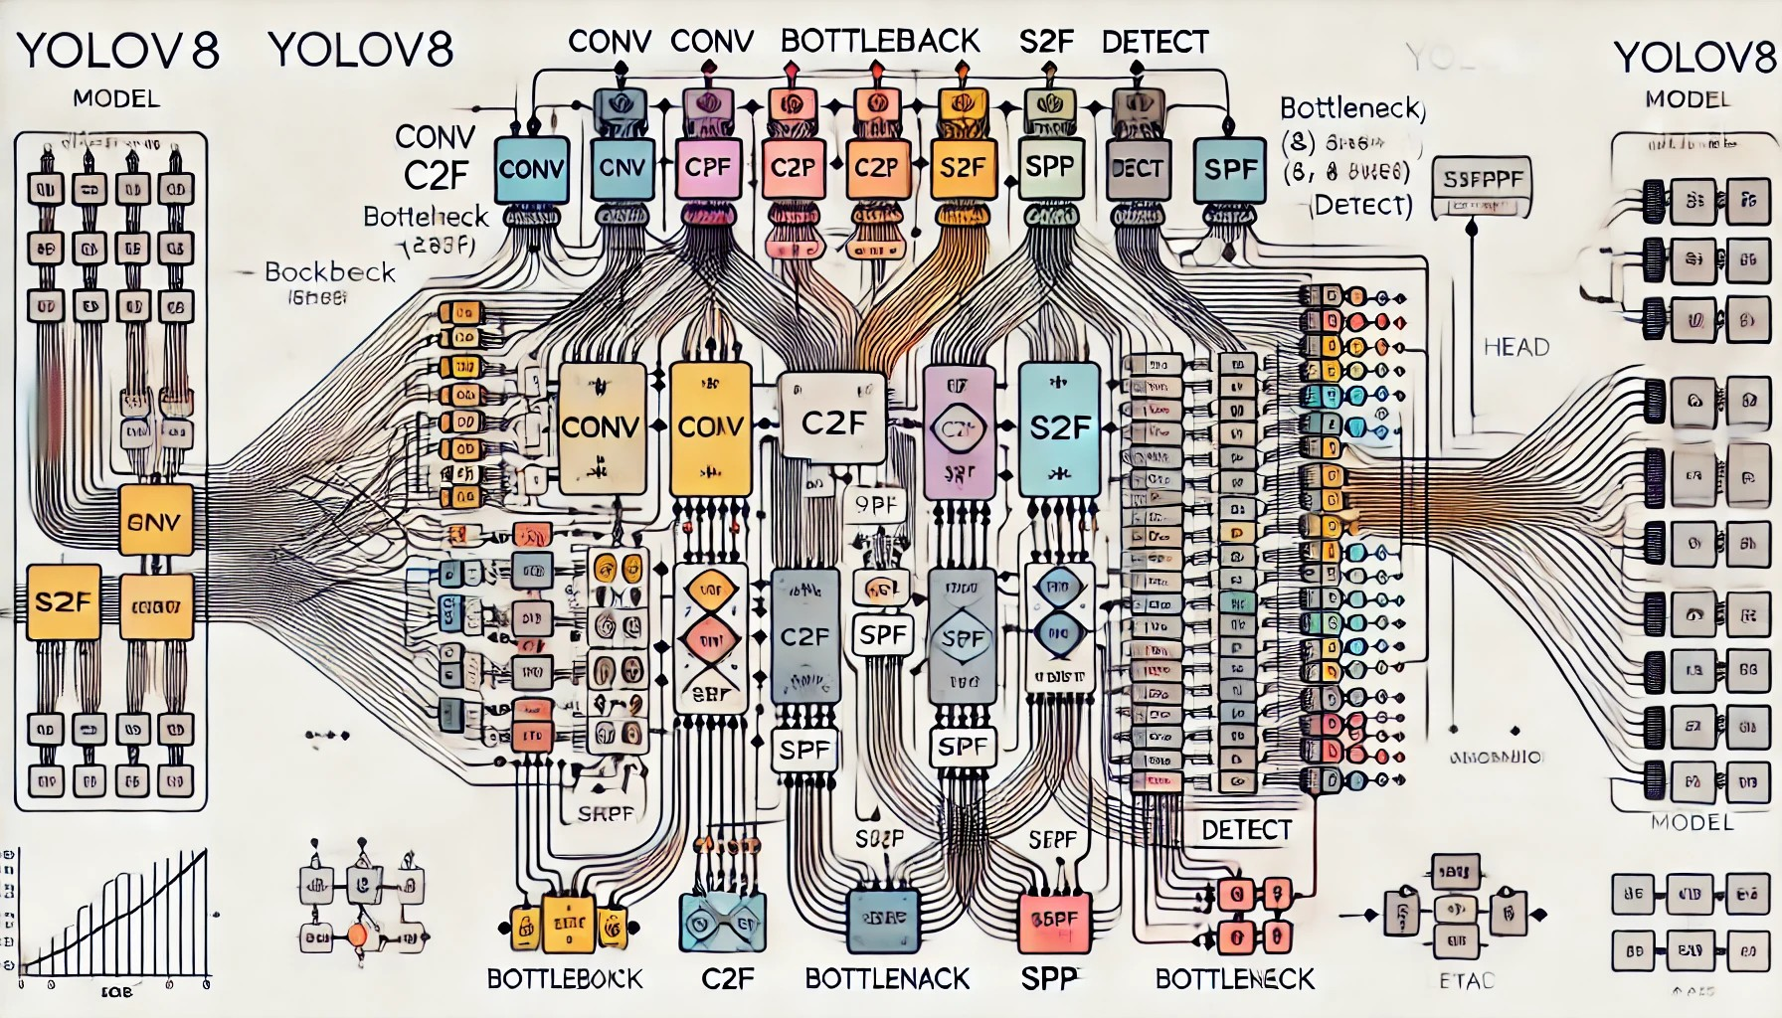
0 5 : A R C H I T E C T U R E D I A G R A M

Slide 10
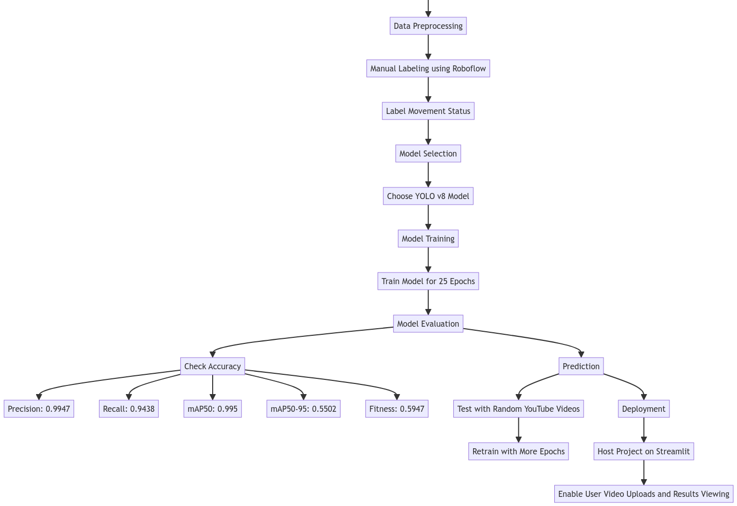
0 5 : M O D E L F L O W D I A G R A M

Slide 11
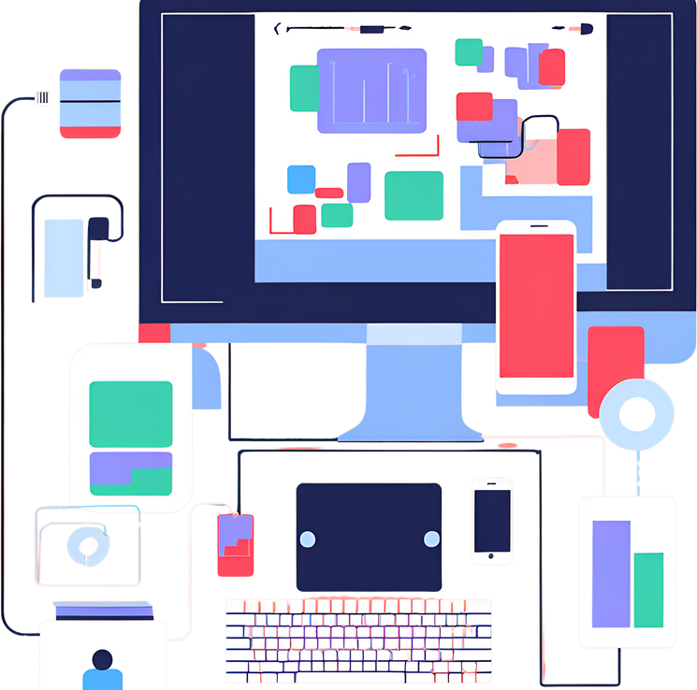
0 6 : T E C H N O L O G I E S U S E D
YOLOv8: Used for object detection and classification. Python: Core programming language for scripting and model development.
OpenCV: Handled video processing tasks, including frame extraction and manipulation.
NumPy : Facilitated numerical operations and data handling, providing a foundation for efficient calculations.
Streamlit: Enabled us to create the web application interface, making it easy for users to interact with the system, and for Hosting also.
PyTorch: Assisted in loading and running the YOLO models, providing the necessary deep learning infrastructure.
Roboflow: Managed dataset labeling and organization, streamlining the data preparation process.

Slide 12

0 6 : T E A M M E M B E R A N D C O N T R I B U T I O N S
Nagothu Sravani Vimala Rani URK21CS2033:
Conceptualized and designed the project.
Developed the YOLOv8 models for people and movement detection.
Rathipinni Yogiswar URK21CS1122:
Implemented the data preprocessing and labeling.
Built the Streamlit web application for video upload and analysis.
C Hareesh URK21CS7001:
Managed the entire project lifecycle, from ideation to deployment.
Conducted extensive testing and validation to ensure the system's accuracy and reliability.

Slide 13

0 7 : C O N C L U S I O N
Our ICU Monitoring System introduces an innovative solution to enhance patient care through real-time monitoring and automated alerts. By harnessing advanced AI technologies, this system aims to assist healthcare professionals in maintaining vigilant oversight of ICU environments, ultimately improving patient safety and healthcare outcomes. This project illustrates the potential of AI in revolutionizing healthcare and underscores the importance of ongoing innovation in medical technologies.

Slide 14

0 8 : F U T U R E W O R K
Enhanced Detection Models: We plan to integrate more advanced models or improve existing models to increase accuracy and reduce false positives.
Real-Time Monitoring: We aim to implement real-time video processing to provide immediate alerts and notifications to healthcare professionals.
Expanded Dataset: We intend to collect more diverse and comprehensive datasets to improve model robustness and adaptability to various ICU environments.
Mobile Application: Develop a mobile app for healthcare providers to receive real-time alerts and updates on the go, ensuring they are always informed.
Integration with Hospital Systems: We aspire to connect the monitoring system with hospital management systems for seamless data integration and better patient management.

Slide 15

C O N T A C T D E T A I L S
Name –
Chamarti Hareesh Kumar
Rathipinni Yogiswar
Nagothu Sravani Vimala Rani
Email –
chamarthihareesh@karunya.edu.in
rathipinniyogiswar@karunya.edu.in
nagothusravani@karunya.edu.in

Slide 16


R E F E R E N C E S
1 . Y o u T u b e : V a r i o u s I C U s c e n a r i o v i d e o s f r o m Y o u T u b e w e r e
i n s t r u m e n t a l i n c r e a t i n g a d i v e r s e a n d c o m p r e h e n s i v e d a t a s e t f o r t r a i n i n g a n d t e s t i n g t h e Y O L O v 8 m o d e l s . T h e s e v i d e o s
p r o v i d e d r e a l w o r l d e x a m p l e s o f I C U e n v i r o n m e n t s , w h i c h w e r e e s s e n t i a l f o r a c c u r a t e m o d e l t r a i n i n g .
. Y O L O v 8 D o c u m e n t a t i o n : T h e o f f i c i a l d o c u m e n t a t i o n a n d
t u t o r i a l s f o r Y O L O v 8 w e r e c r u c i a l i n u n d e r s t a n d i n g t h e m o d e l a r c h i t e c t u r e a n d i m p l e m e n t a t i o n d e t a i l s .
. R o b o f l o w : T h i s t o o l w a s e s s e n t i a l f o r d a t a l a b e l i n g a n d
o r g a n i z a t i o n , s t r e a m l i n i n g t h e d a t a s e t p r e p a r a t i o n p r o c e s s .
. S t r e a m l i t : T h e S t r e a m l i t d o c u m e n t a t i o n a n d c o m m u n i t y f o r u m s p r o v i d e d v a l u a b l e i n s i g h t s i n t o b u i l d i n g a n d d e p l o y i n g t h e w e b a p p l i c a t i o n .
. A c a d e m i c P a p e r s a n d A r t i c l e s : S e v e r a l r e s e a r c h p a p e r s a n d
a r t i c l e s o n o b j e c t d e t e c t i o n a n d d e e p l e a r n i n g m o d e l s p r o v i d e d t h e o r e t i c a l i n s i g h t s a n d p r a c t i c a l g u i d a n c e .

Slide 17


